Slide 1

The Single-Sample t Test
Chapter 9

Slide 2
t distributions
Sometimes, we do not have the population standard deviation, σ.
Very common!
So what can we do?

Slide 3
t distributions
The t distribution is used when we do not know the population information.
So we use the sample to estimate the population information.
Because we are using the sample, the t distribution changes based on that sample.

Slide 4
The t Statistic
When sample size increases:
s or sd (the spread of t) → σ
Therefore, t and z become more equal
The t distributions
Distributions of differences between means

Slide 5
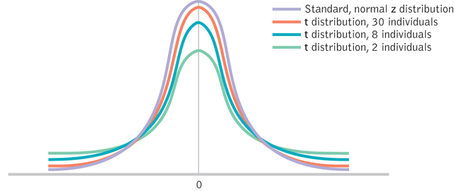
Wider and Flatter t Distributions

Slide 6
Check Your Learning
When would you use a z test?
When would you use a t test?

Slide 7
Types of t
Single sample t
One sample (group of people), population mean to compare against
Dependent sample t
One sample tested twice to compare those two scores
Independent sample t
Two samples to compare those two groups

Slide 8
Hypothesis Tests: The Single Sample t Test
The single sample t test
When we know the population mean, but not the standard deviation
So, we will use the sample to estimate SD
But that means we have to use the sample to estimate cut off scores too, since the distribution spread is not set.

Slide 9
The t test
The six steps of hypothesis testing
1. Identify population, distributions, assumptions
2. State the hypotheses
3. Characteristics of the comparison distribution
4. Identify critical values
df =N-1
5. Calculate
6. Decide

Slide 10
Hypothesis Testing: Step 1
Assumptions:
DV is scale
Random selection → random assignment?
Normal → N > 30?

Slide 11
Hypothesis Testing: Step 2
Label the sample and the population
Pick a null and research
Remember the combinations are:
Greater
Lesser
Two Tailed = Different

Slide 12
Hypothesis Testing: Step 3
Label:
Sample M
Sample SD
Sample SE
Sample N
Population u

Slide 13
Hypothesis Testing: Step 3
Something new:
Degrees of freedom
df = N - 1 where N is sample size
This number is used in two ways:
Estimation of SD
Calculating the cut off score

Slide 14
t distributions
Sample Standard Deviation
Population Standard Deviation
What we did before…
Biased estimate
New formula…
Unbiased estimate
Based on some error

Slide 15
Calculating in R
summary(dataset)
mean(dataset, na.rm = T)
sd(dataset$column, na.rm = T)
OR you can enter the data:
data = c(#,#,#,#,#)
sd(data, na.rm = T)

Slide 16
Calculating Standard Error for the t Statistic
Using the standard error

Slide 17
Calculating in R
se = sd / sqrt(N)
If you have all the data in R you can try:
sd(data) / sqrt(length(data))
Remember the sd function gives you SD
The sqrt() function is square root
length() calculates the number of items or N
Remember that data can be one column or dataset$column

Slide 18
Hypothesis Testing: Step 4
Use df to find the cut off score
qt(alpha p, df, lower.tail = T or F)
Alpha p is set at .05 or .01
Remember, for a two tailed test, do alpha / 2

Slide 19
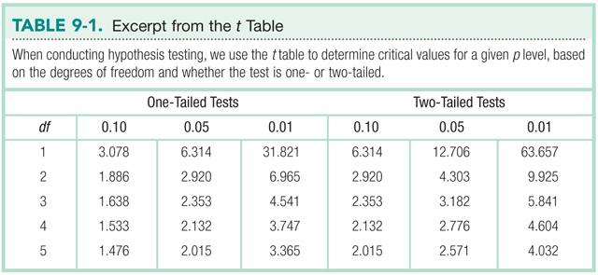
Stop and think. Which is more conservative: one-tailed or two-tailed tests? Why?

Slide 20
Hypothesis Testing: Step 5
The t found statistic

Slide 21
Calculating in R
To get t
Mean – mu / se
If you have the calculated numbers (i.e. you are given M, u, SD, N), then you can fill in the formulas.
If you are given the raw numbers, then we can calculate with the t.test() function.

Slide 22
Calculating in R
t.test(column of y data,
mu = #,
alternative = “less” OR “greater” OR “two.sided”,
conf.level = .95 OR .99)
Note: alternative and conf.level options.

Slide 23
Hypothesis Testing: Step 6
Decide to reject or fail to reject the null hypothesis.
Beyond hypothesis testing:
Calculate effect size
Calculate confidence interval

Slide 24
Calculating Effect size

Slide 25
Confidence Interval
We are usually discussion two tailed confidence intervals
You can do one tailed confidence intervals but they are not very common.
They are calculated in the same way as z-tests but with a t-critical instead of z-critical.

Slide 26
Confidence Interval
Lower = M_{sample} – t_{critical}*SE
Upper = M_{sample} + t_{critical}*SE
A quicker way!
Use t.test() with a TWO tailed test to get the two tailed confidence interval.

Slide 27
Interpretation of Confidence Interval
If we were to sample N students from the same population over and over, the 95% confidence interval would include the population mean 95% of the time.

Slide 28
t, Effect Size, and Confidence Interval Cheat!
Use the effsize and calculate code Dr. B has written.
Not required, but if you want to check to make sure you doing it correctly.
Definitely much easier to use when calculating d for other types of t-tests.

Slide 29
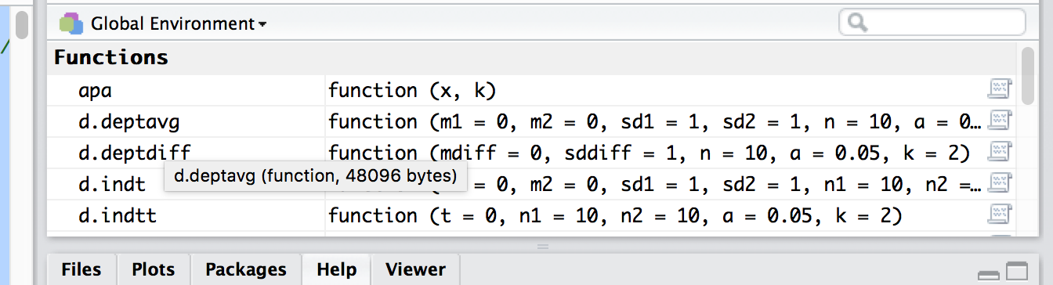
t, Effect Size, and Confidence Interval Cheat!
Make sure the functions appear in your window or you won’t be able to use them!

